Slide 1
Narcovet
Giulia Bleichenbacher
Sarah Deckarm
Leonie Isele
Firat Turan
The solution for automated management of narcotics in veterinary practice

Slide 2
The problem we tackle:
Narcotics require strict documentation
Often no automation and paper based
No clear path of communication
No clear responsibilities defined

Slide 3
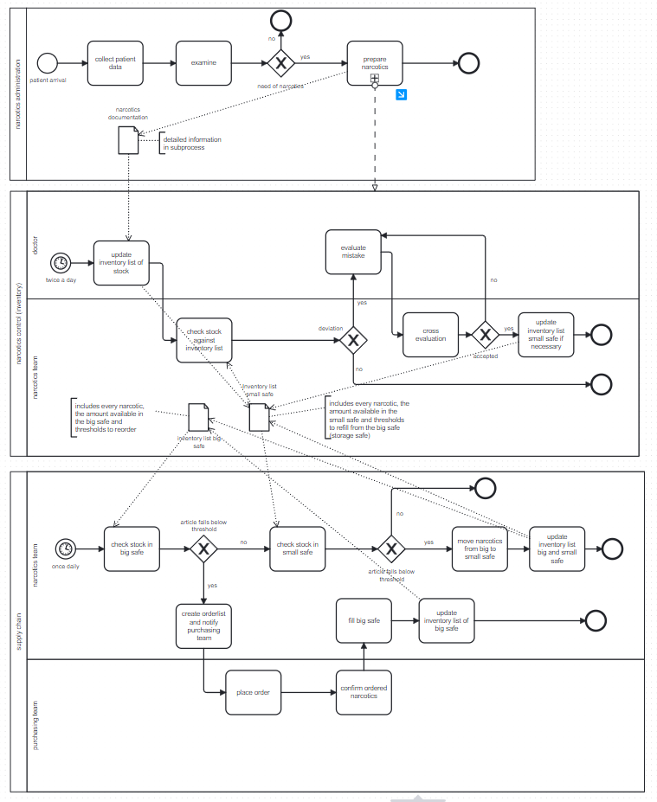
AS IS Process

Slide 4
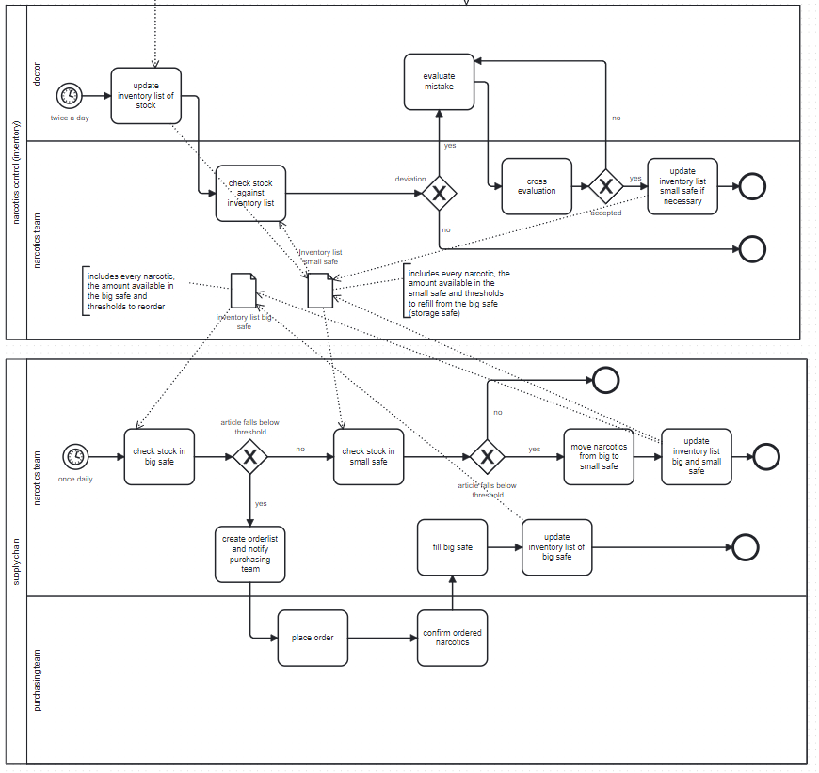
AS IS Process – main process of interest

Slide 5
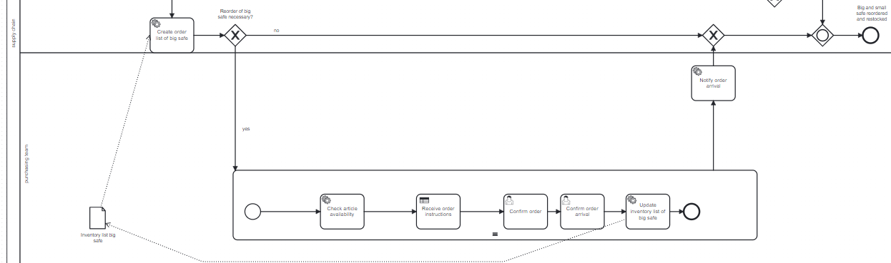
TO BE Process
Notes:
Now to the second path of the process, which automatically reorders items for which the stock is low in the big safe. The process starts with the creation of the service task. This is a process step which automatically determines how which items and how much as to be reordered for each narcotic available. If there are any that have to be reordered the process loops through each item. The first step is always to control if this item is available for reorder. This is implemented with a process task which simulates a real API that returns global drug shortages. Next we have implemented a decision table that reads the response of the API and if necessary returns alternatives to the requested narcotic.
After the process receives the reordering instructions they are presented to a member of the purchasing team. The purchasing has to then confirm that the medication arrived. The quantities in the big safe are updated automatically by a service task.
After this subprocess has finished for all narcotics in the reorder list the narcotic team is notified via email.

Slide 6
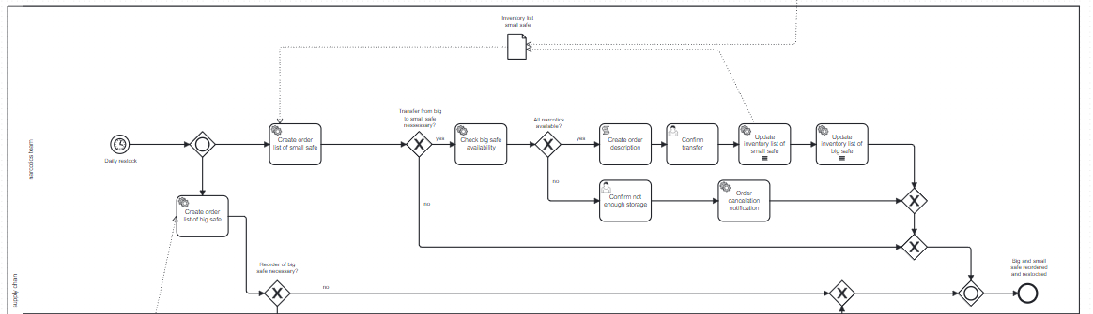
TO BE Process
Notes:
#

Slide 7
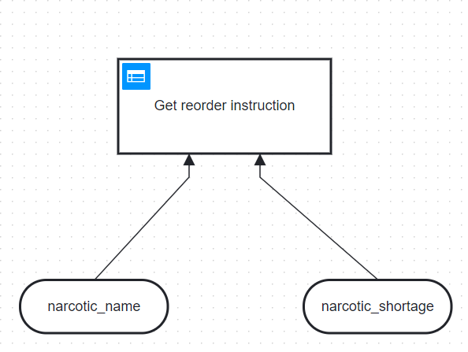
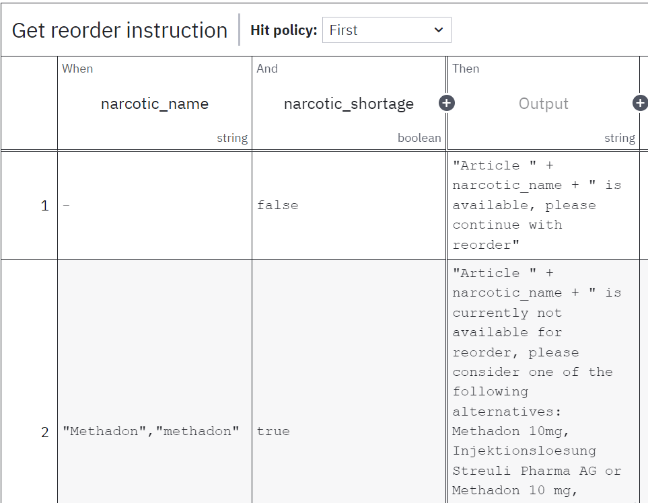
TO BE Process
Notes:
This is what that looks like in detail, we have an input of the narcotic name and whether there is a shortage. If there is no shortage the process gives instructions about reordering the same article. If there is a shortage the decision table proposes alternatives for each narcotic.

Slide 8
Demonstration
Let us show it to you in a video

Slide 9
Benefits
Narcotics management
Reduction of hours:
180h per year without Narcovets
67h per year with Narcovets
Reduction of expenses:
10.000CHF per year without Narcovets
5.000CHF per year with Narcovets
Cherry on top:
Centralized documentation
Less risk for human errors or human intervention for misuse

Slide 10
Conclusion
Problems
Solutions
Exlusively paper based
No automation
Unclear responsibilities
Time consuming
No decision support for alternative medications
Inventory list: digitalized
Automated e-mail generation
For order arrival
Threshold warning
Decision logic implemented to enable quick access to alternative medications

Slide 11
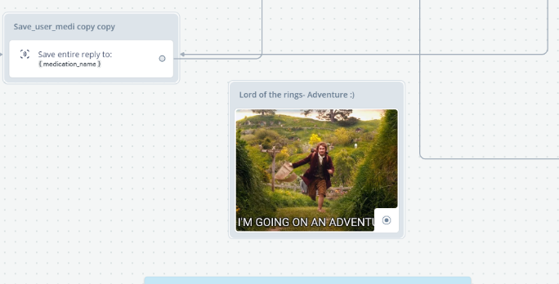
Addendum: Chatbot adventures ☺

Slide 12
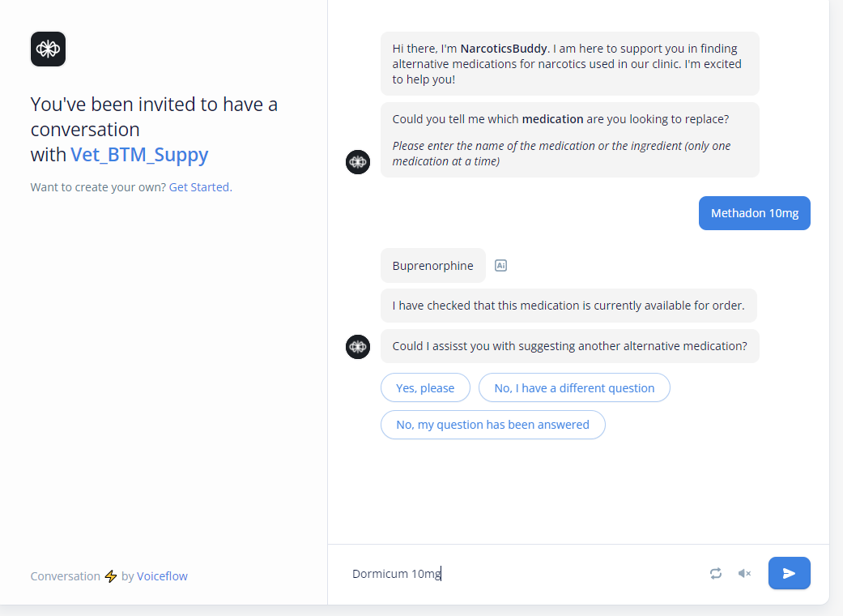
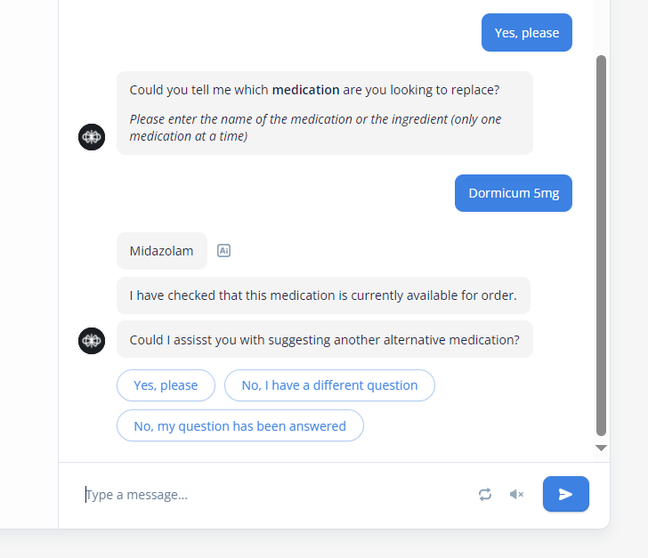
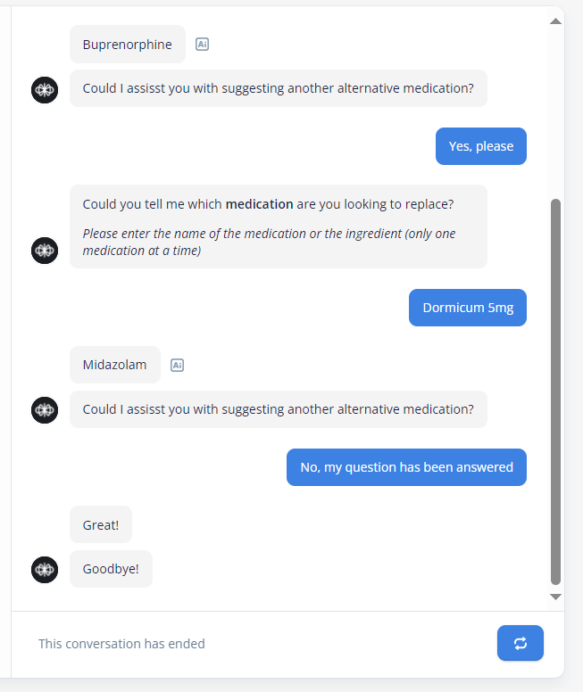
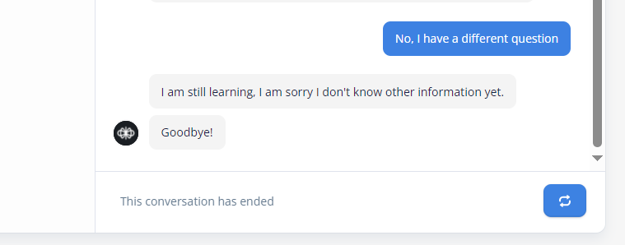

Slide 13
We initially explored the option to implement a chatbot to give the narcotics team the possibility to chat and get a suggestion for an alternative medication.
In this process we faced some issues however, and ultimately after a longer discussion with both Charuta and Devid during the course of different coachings, we decided to leave this idea, but we briefly wanted to illustrate what we did here.
We learned a lot regarding voiceflow, chatbot implementation and a lot of the «details» in setting up such a chatbot. ☺ It was a really interesting exploration of the topic
Creating, adapting and following the «conversation» framework was really interesting!

Slide 14
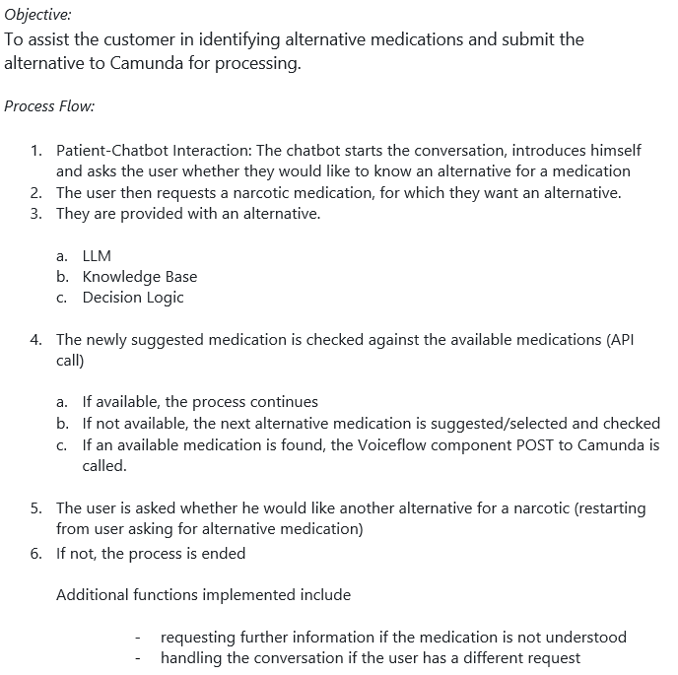
Some successes, some challenges

Slide 15
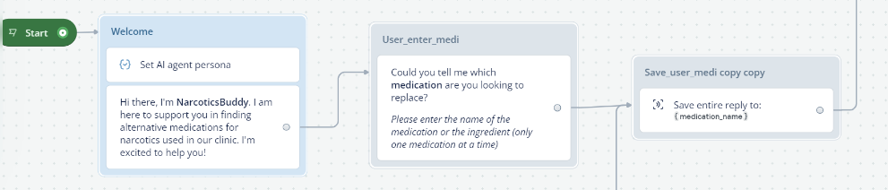
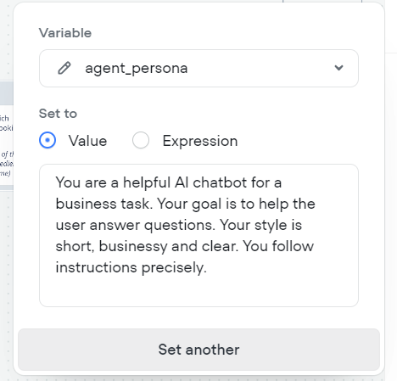
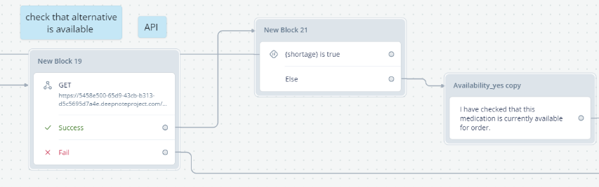
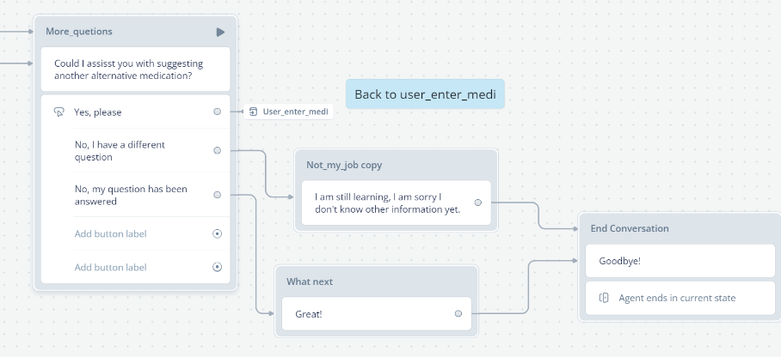
Intro
API Call to check availability
Defining an agent persona
Conversation Flow, and end

Slide 16
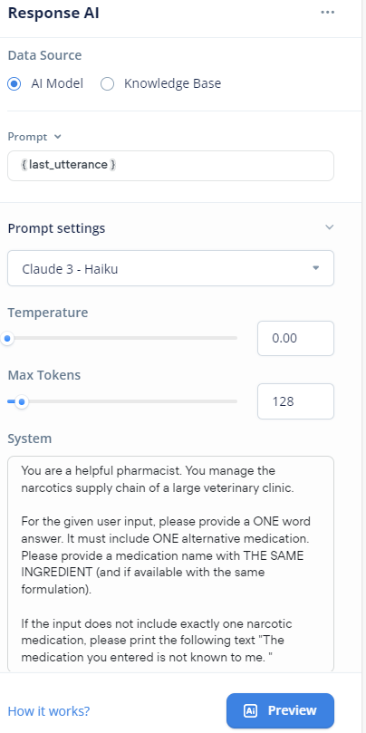

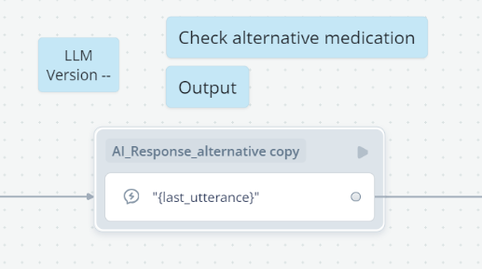

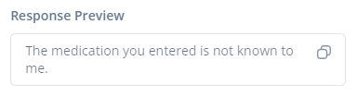
Challenge nr. 1:
LLM →
methadon
dormicum
sunshine

Slide 17
Our initial idea was to implement a Large Language Model (LLM) to assist in suggesting alternative medications.
The first challenge we encountered was that the LLM initially refused to provide information or suggest alternatives for medications, particularly sensitive substances like narcotics.
Through careful prompting and iterative adjustments, we were able to refine the model to generate alternative suggestions. However, its use in this context remained a questionable issue, raising concerns about reliability and appropriateness.
Additionally, the information output at this stage was not sufficiently practical, leading us to explore alternative solutions.

Slide 18
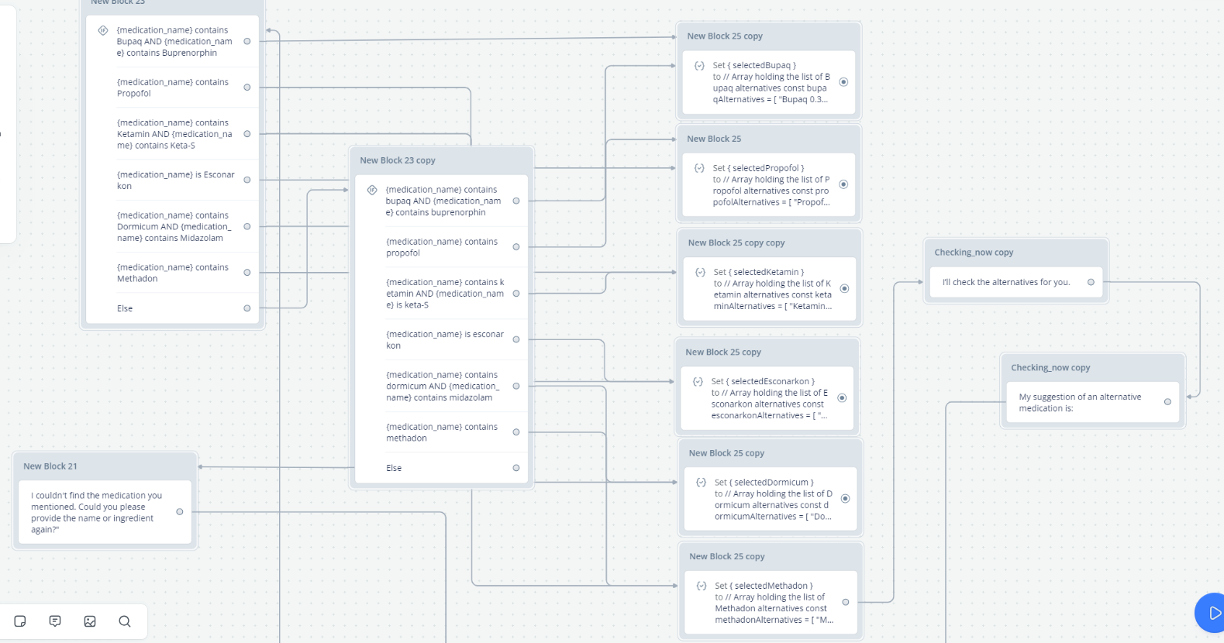
Alternatives…. logic

Slide 19
Initially, the logic behind the implementation was somewhat rudimentary but functional, and not very nicely implemented.
It relied on identifying specific parts of words within the input and, based on predefined rules, generated corresponding outputs.
This approach made the outputs reliable and more controllable, particularly in terms of quality.
However, certain scenarios could not be effectively addressed.
For instance, cases where a user states, "I don’t need Bupaq" or asks, "Provide an alternative for X like you did for methadone," fall outside the scope of the predefined logic, potentially causing issues

Slide 20
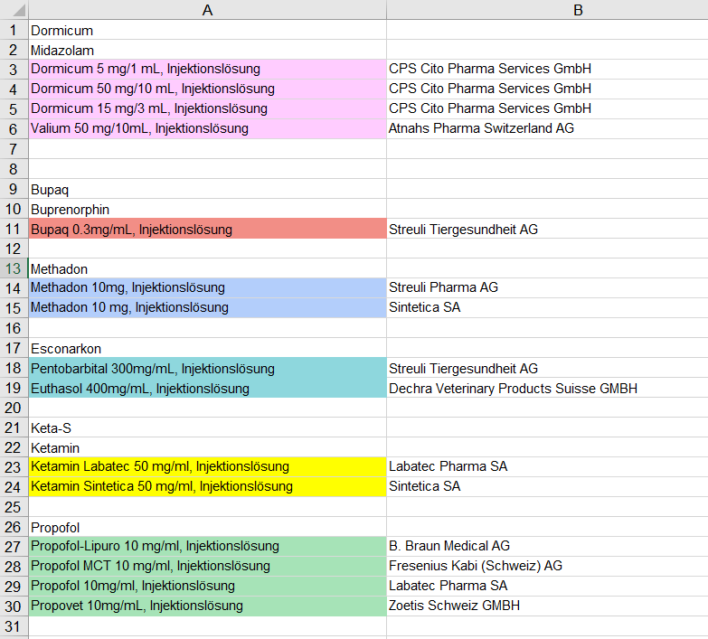
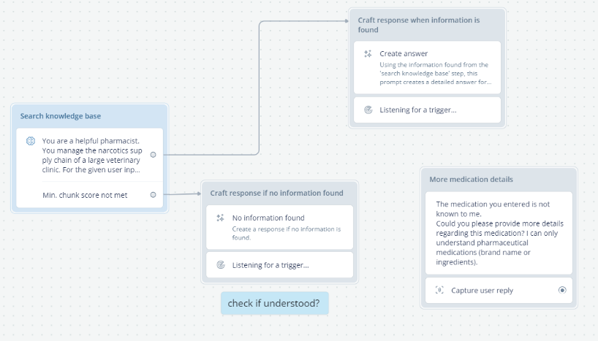
Alternatives…. Knowledge base

Slide 21
Finally, the possibility of utilizing a knowledge base as a foundational resource for the chatbot was explored as a potential solution. However, during subsequent discussions in coaching sessions, it was decided to discontinue this aspect of the project, so it was never truly implemented
Some initial thoughts
Include data on alternative medications and details regarding the narcotic.
Structured base for easy and efficient retrieval and dissemination of information, allowing the delivery of accurate and relevant responses to user inquiries.

Slide 22


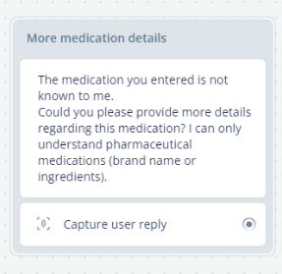
Risks and Considerations
Sensitive Info?
Responsibility?
Necessary?
Correct?

Slide 23
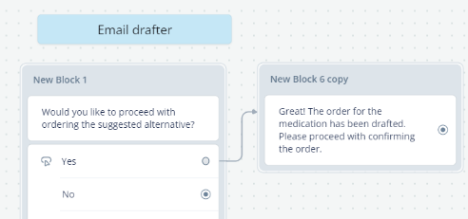

In addition to the risks:
… also elegant possibilities, for example:

